Slide 1
COMPUTER NETWORKS
Assignment 2 part 2 ( video + pcap file)

Slide 2
Open Flow Protocol
Controller
Determine the path of network packets across the network
Routers/switches
OpenFlow allows remote administration of switch/routers packet forwarding tables by adding , modifying and removing packet matching rules and actions

Slide 3
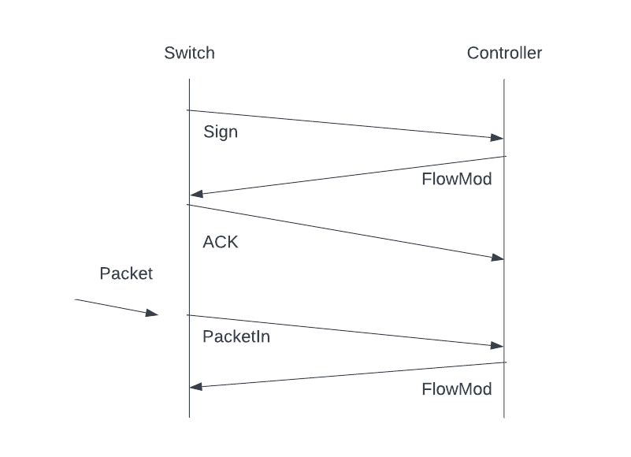
Flow Diagram
This diagram shows a switch contacting the controller with an initial @ Sign @ message
It replies with an acknowledgment
OpenFlow Protocol
As when a switch receives a packet with an unknown destination, it will
contact the controller and receives an
Additional modifications to its flow table
It then receives a modification message to its flow table

Slide 4
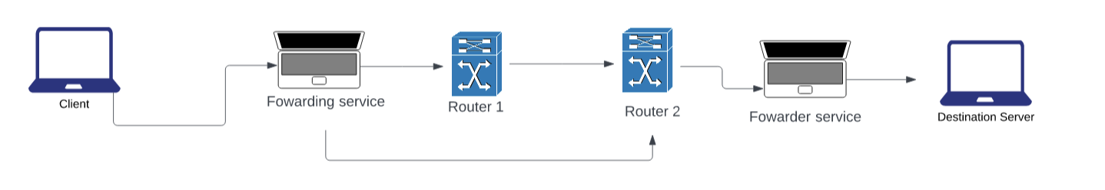
Last Submission

Slide 5
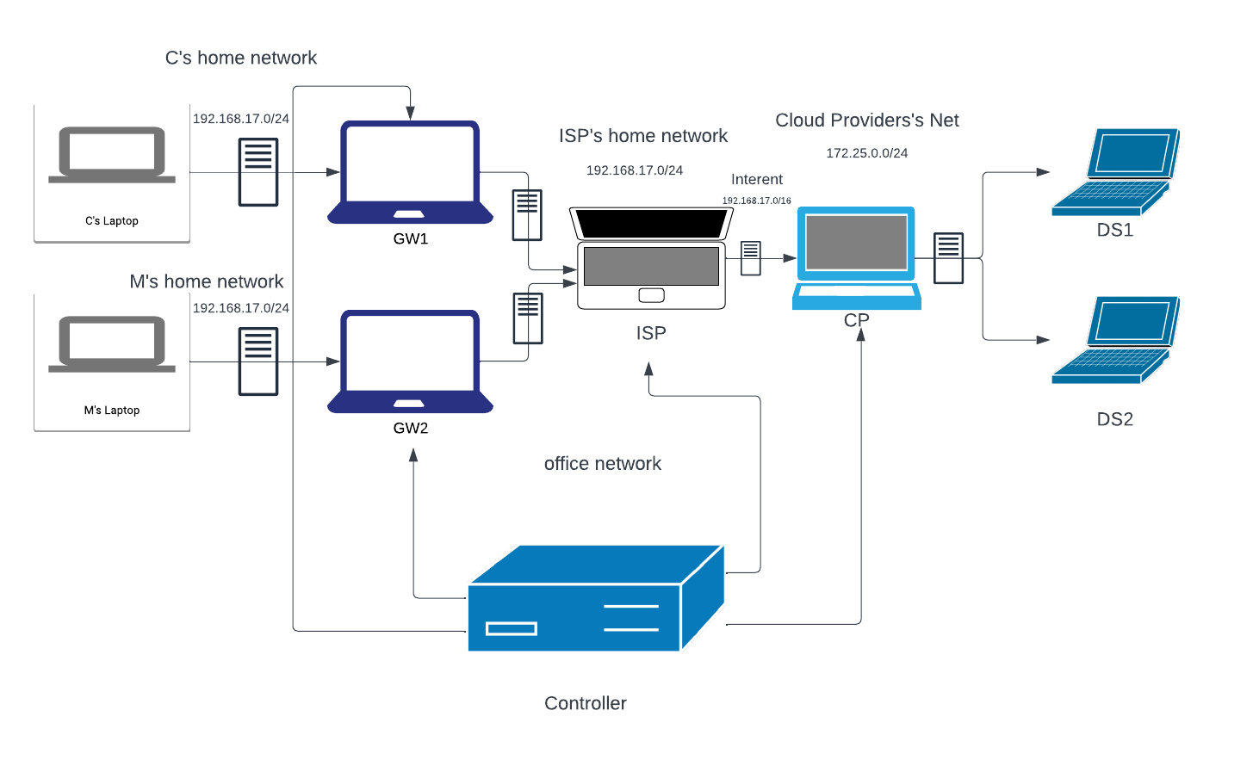
Topology
It includes a number of employees (C and M) with their home networks and a number application servers in their own network. It shows the application server of different networks and the cloud provider .
Controller which will control the network elements which refers to the ISP , GW , CP and switchers

Slide 6
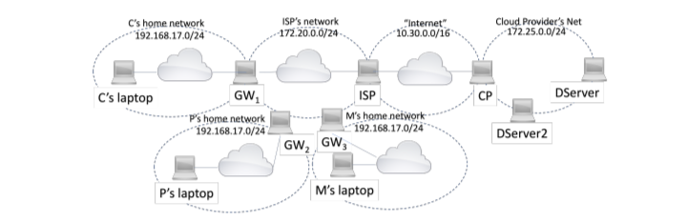
What I am trying to achieve for Part 3
More services to be started in the network of a cloud provider and a number of employees to use applications to communicate with these services at the same time .

Slide 7
Thanks for listening
Aziz

